Slide 1
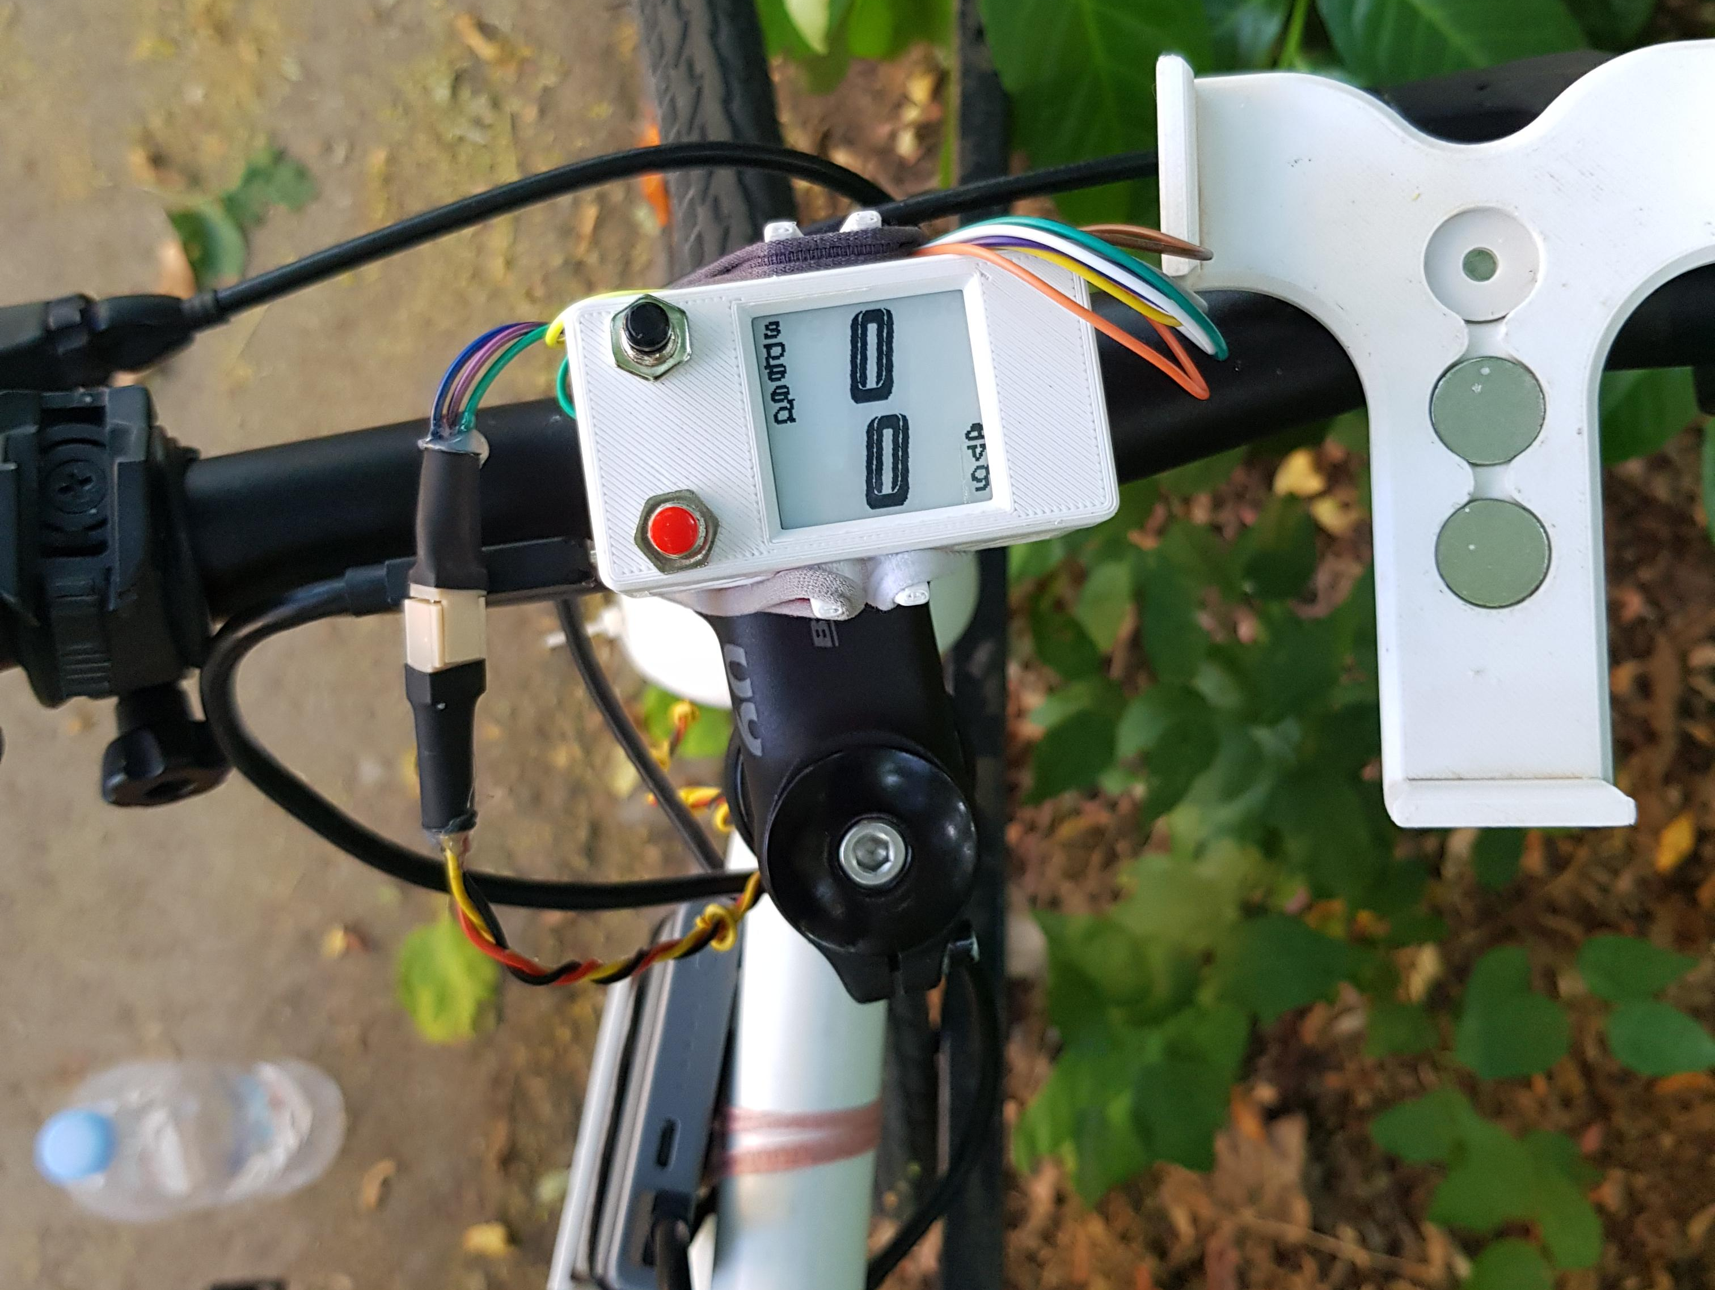
Bike System

Slide 2
About the Project
It’s a bike computer that:
Displays average and instantaneous velocity
Stores data to a micro SD card for post processing
There’s also a Python script that:
Organises the data in trip CSV files
Analyses and plots various metrics about the trips

Slide 3
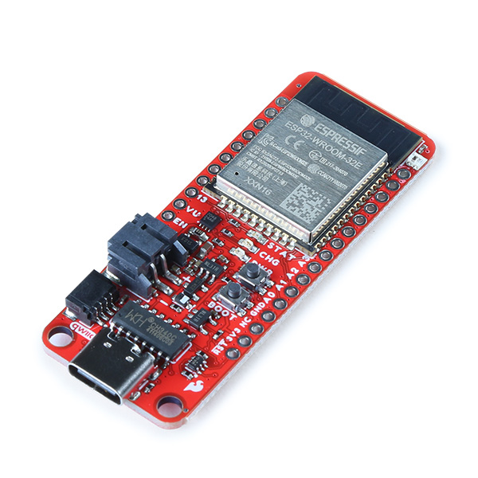
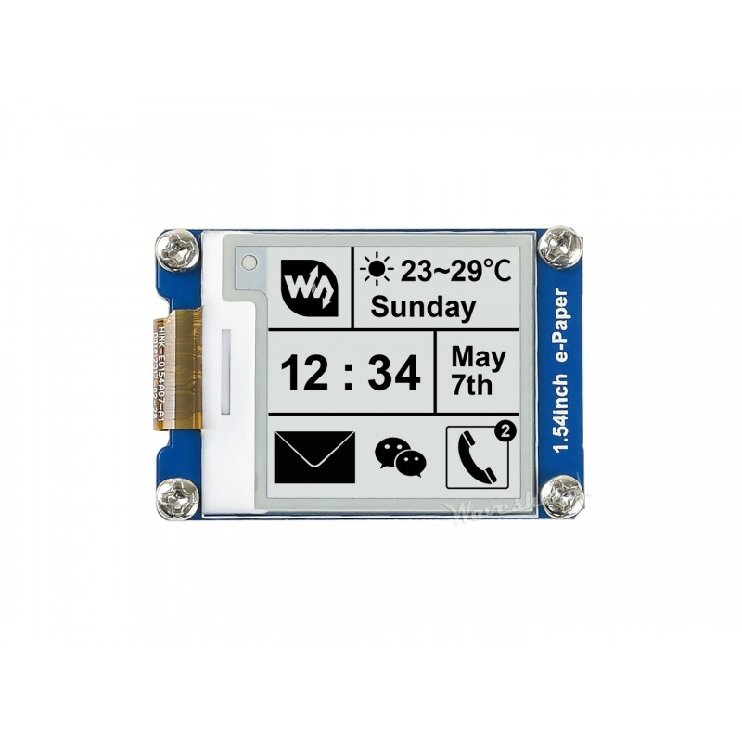
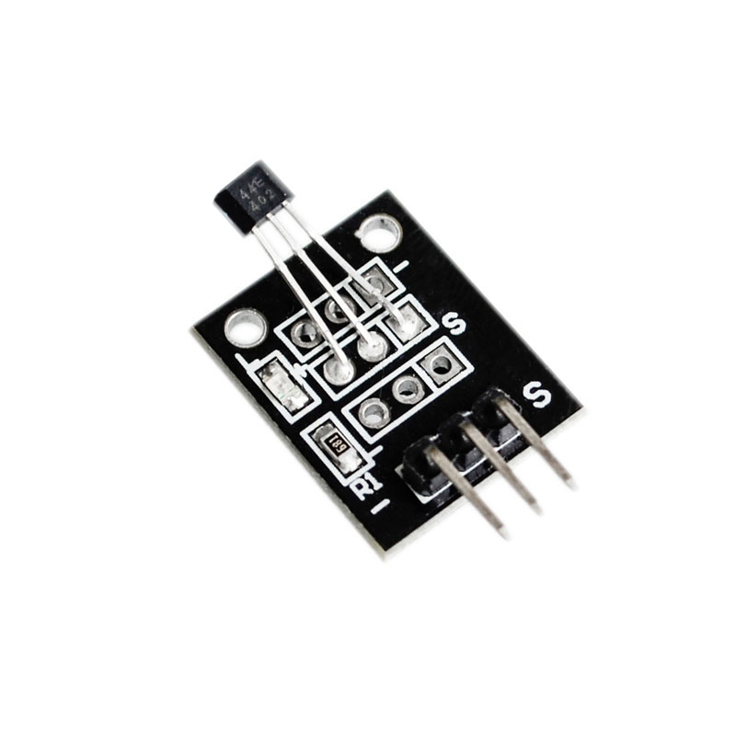
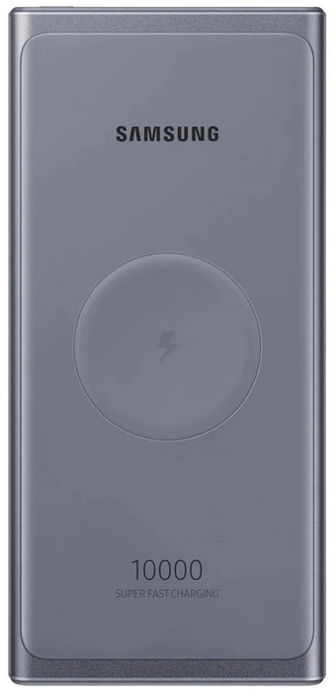
Relevant components
ESP32 Wroom development board
E-Paper Display
Hall Effect Sensor
3D Printed shell
Portable phone charger

Slide 4
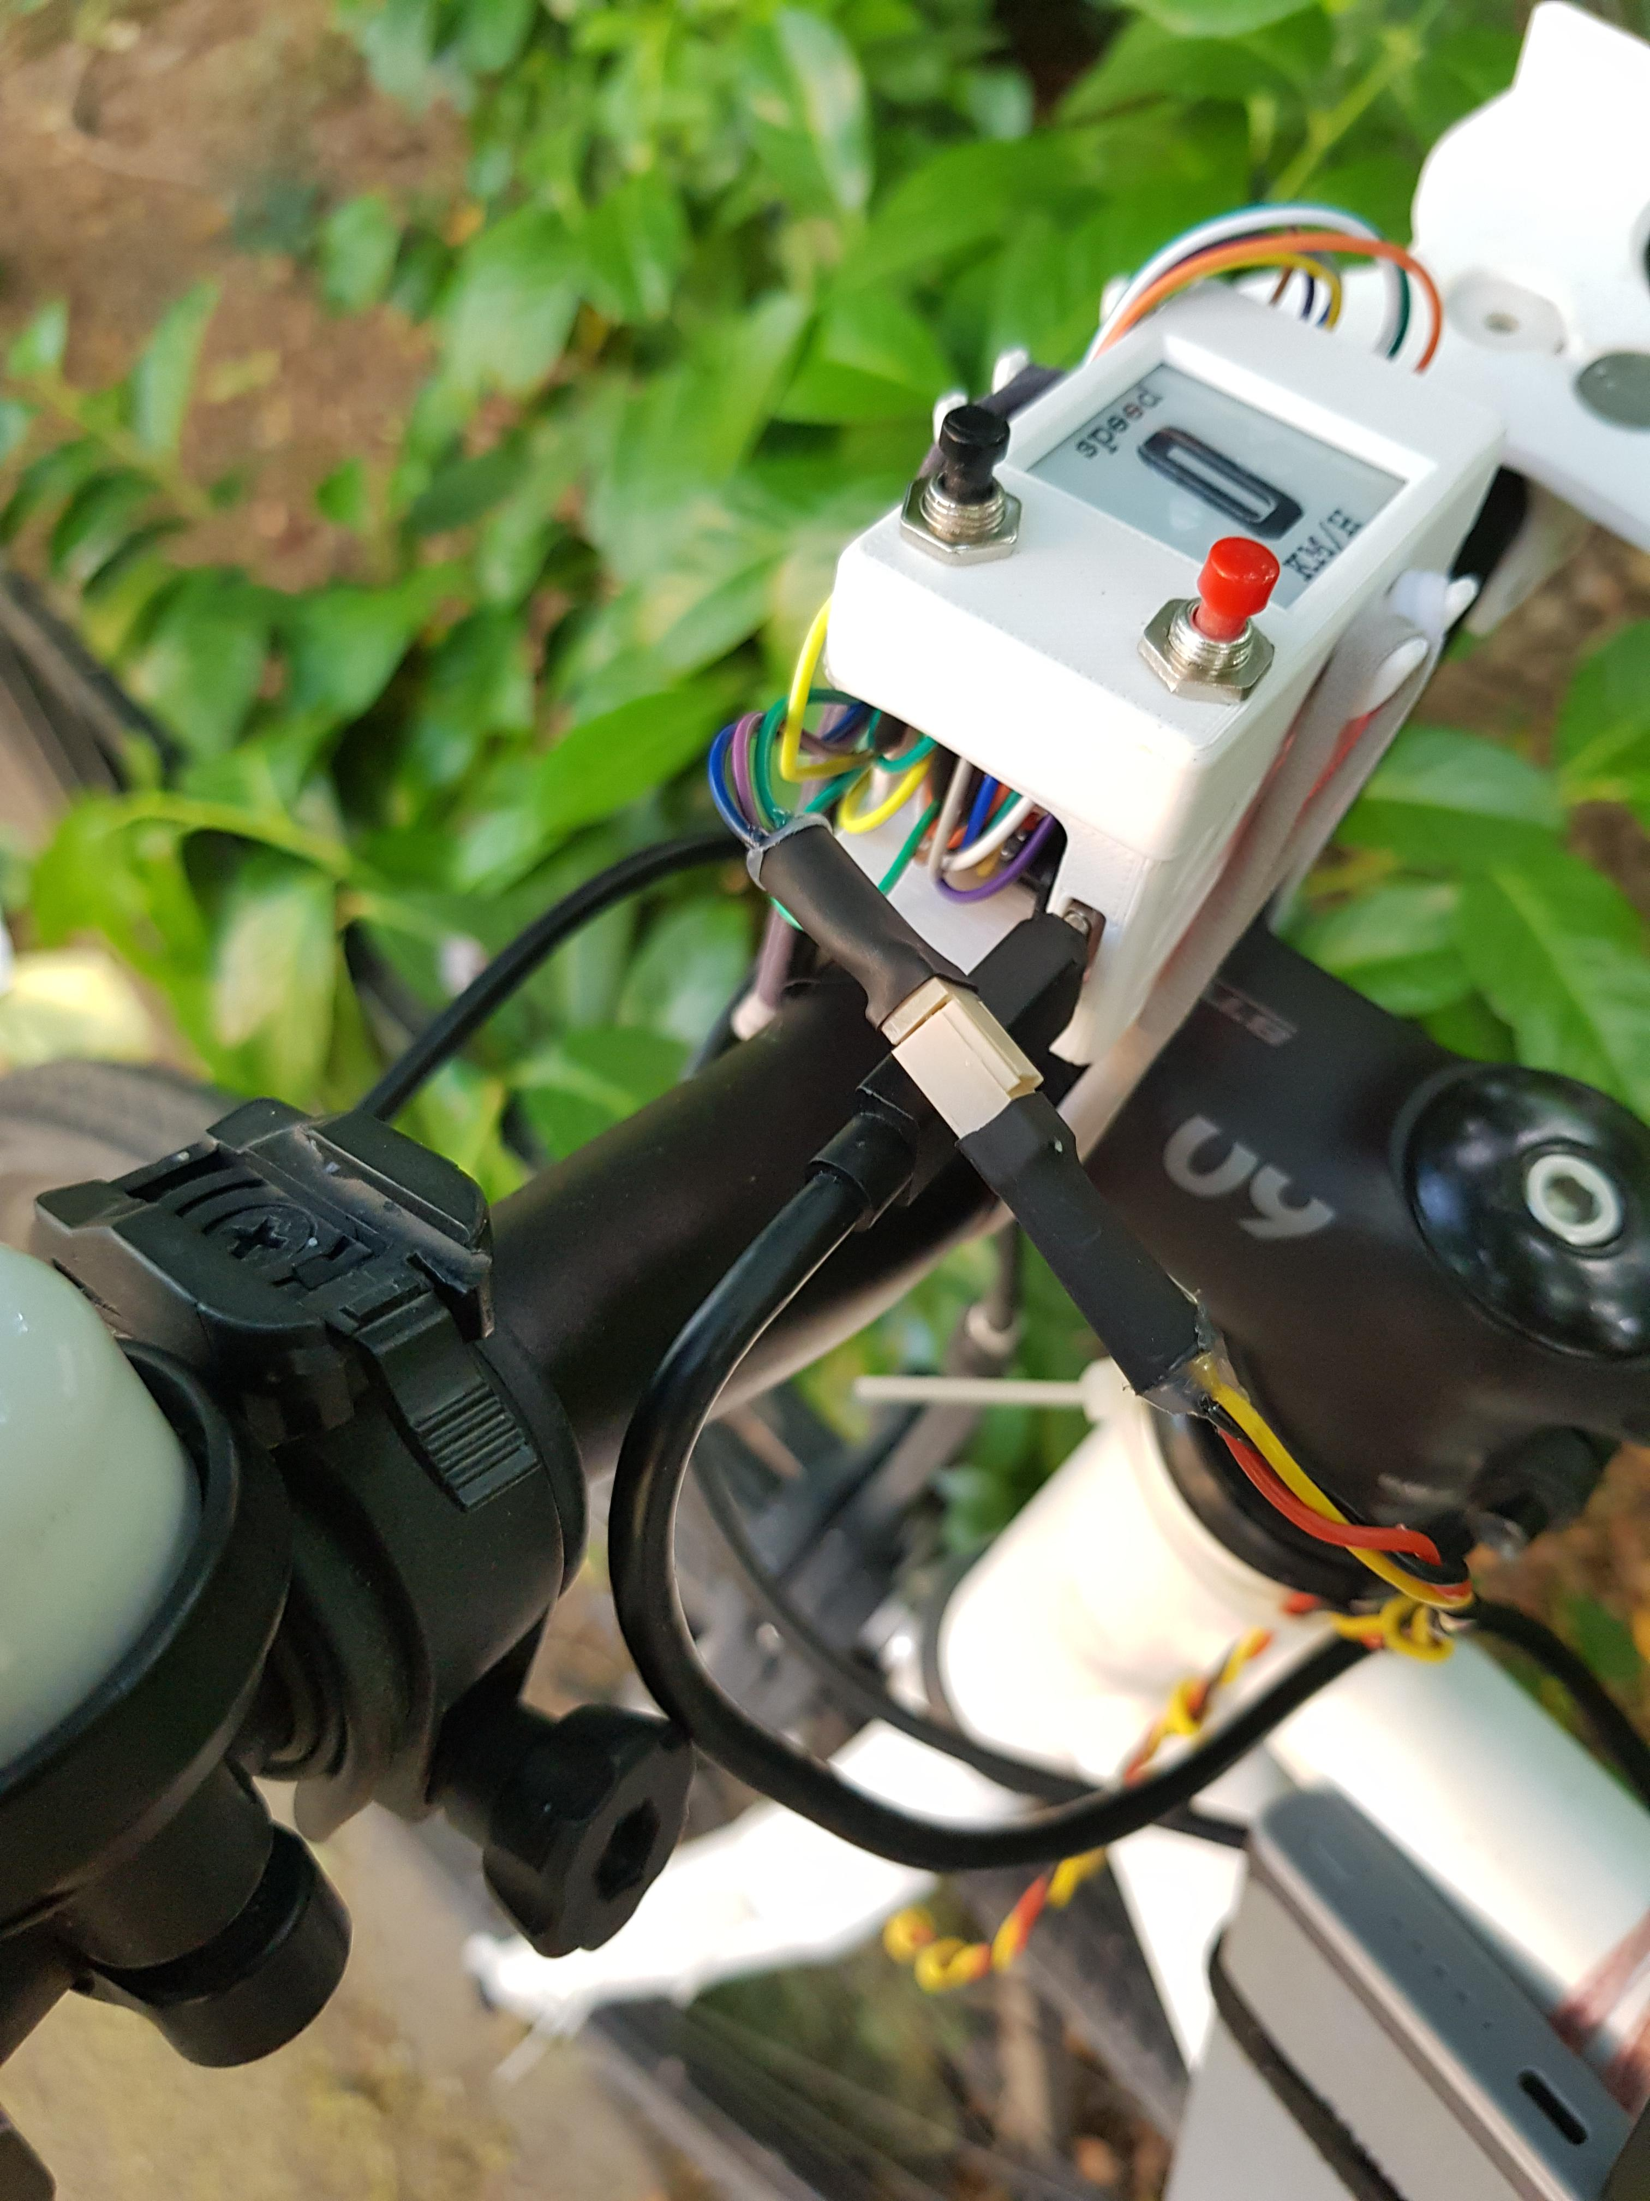
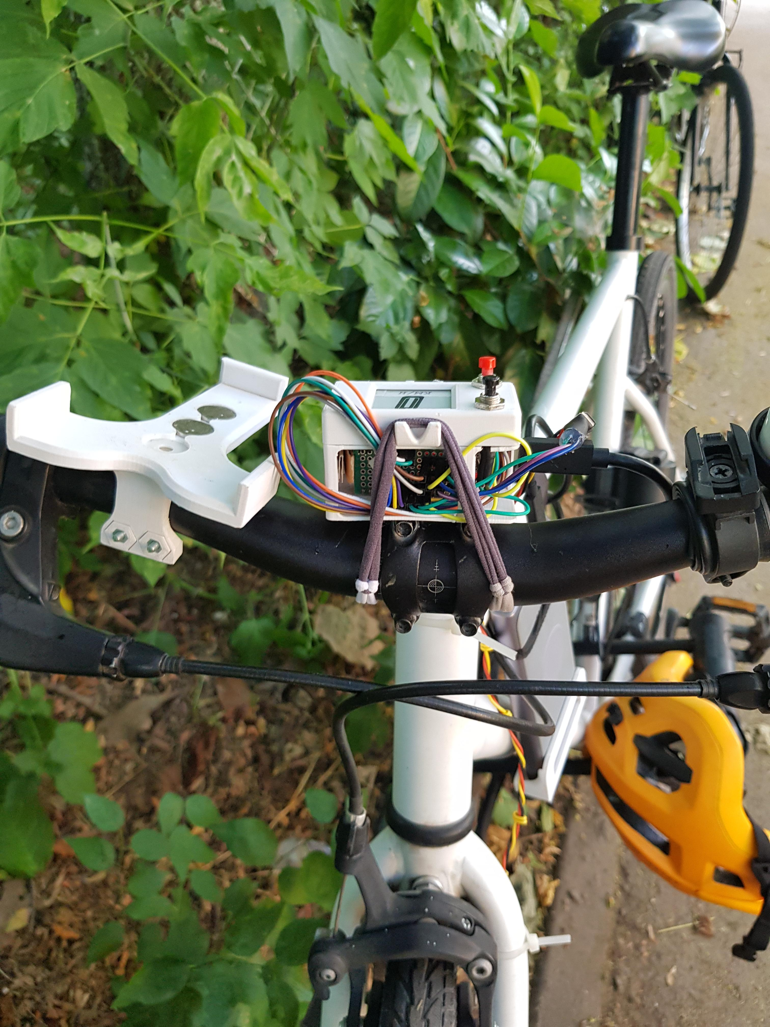
How it works
How it works
The main enclosure is secured with hair ties
Connected to the mcu there is
a USB C wire for power
3 pin connector for the sensor

Slide 5
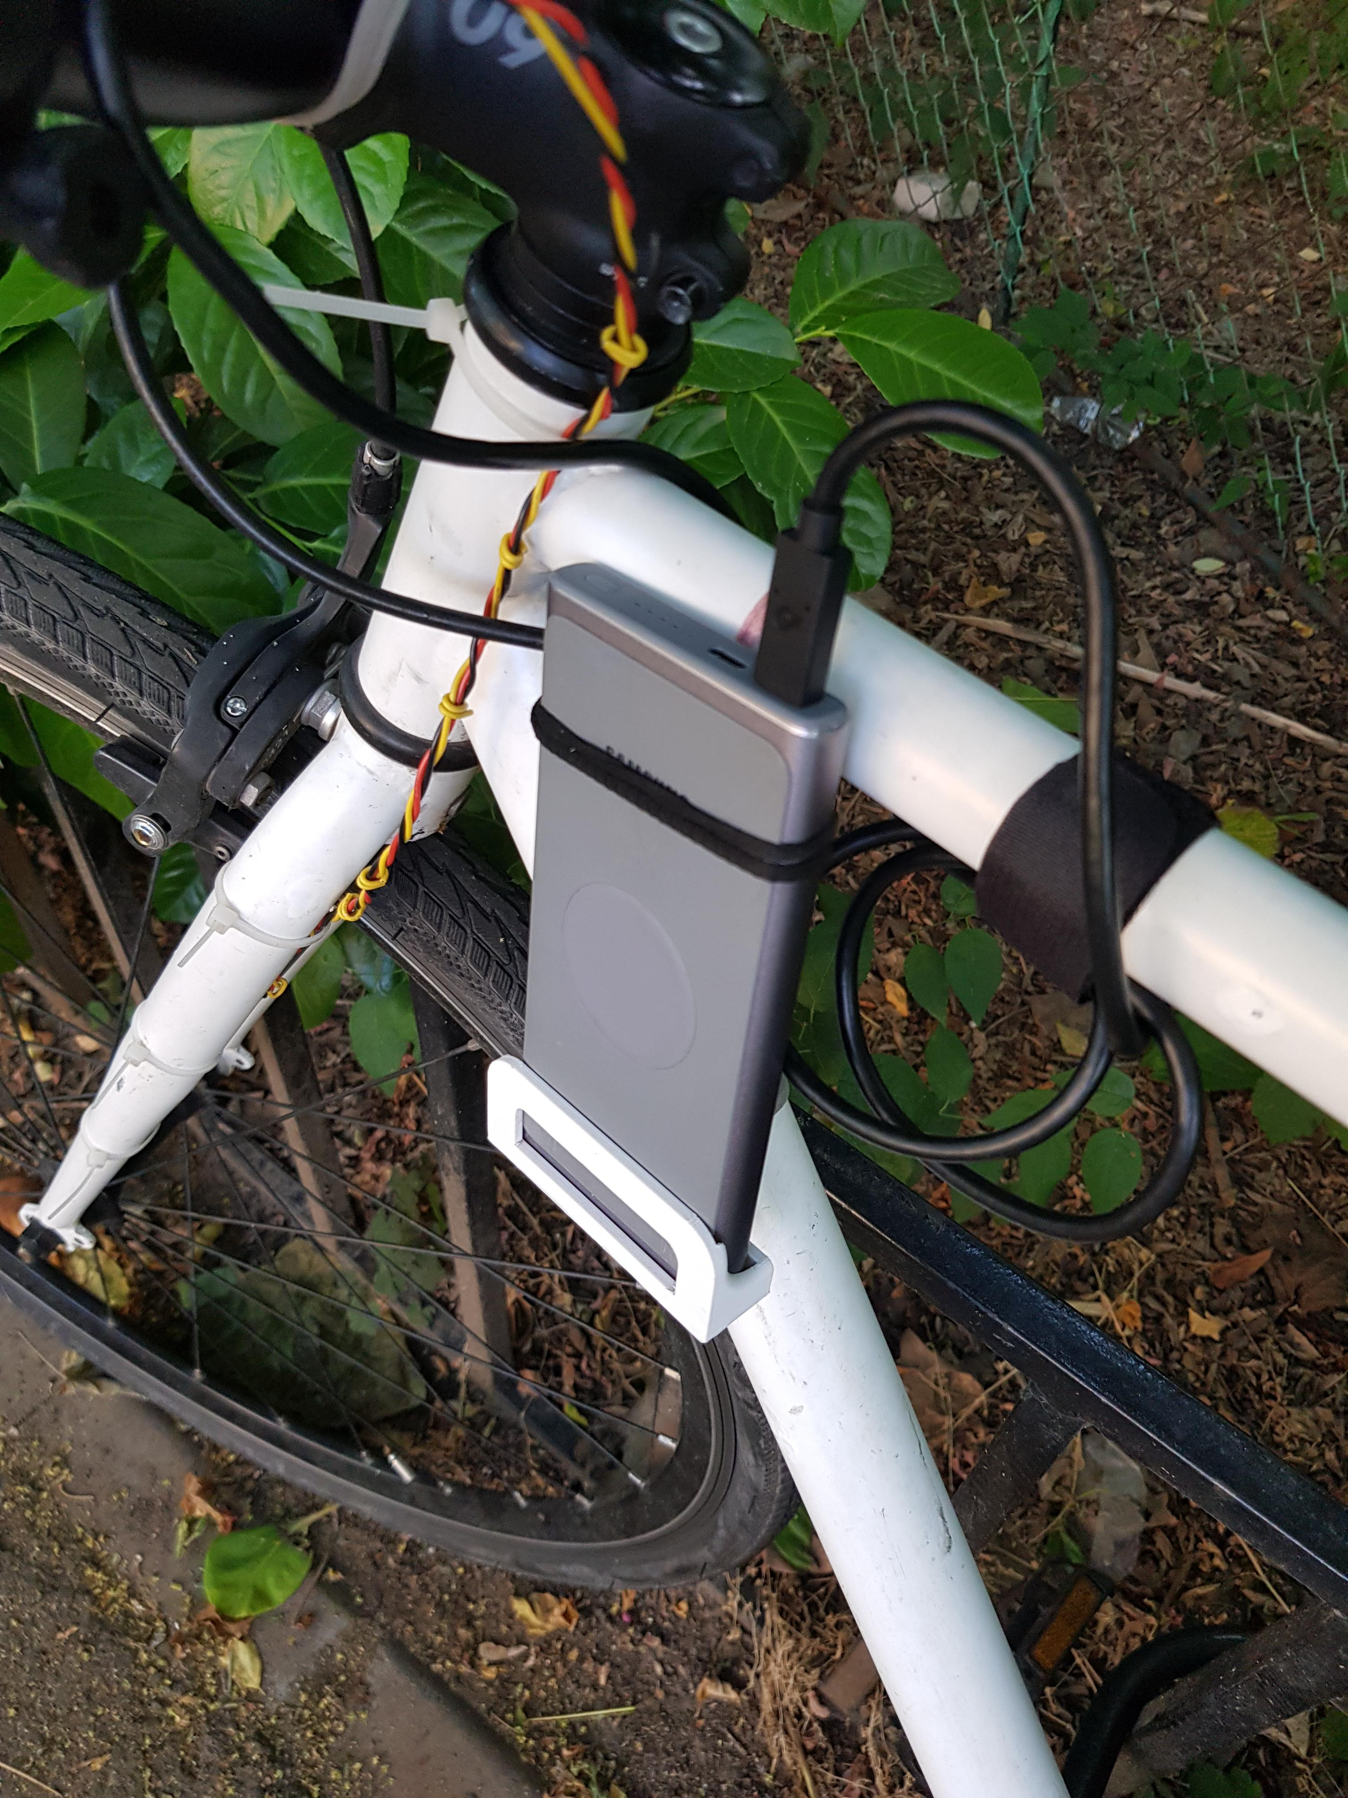
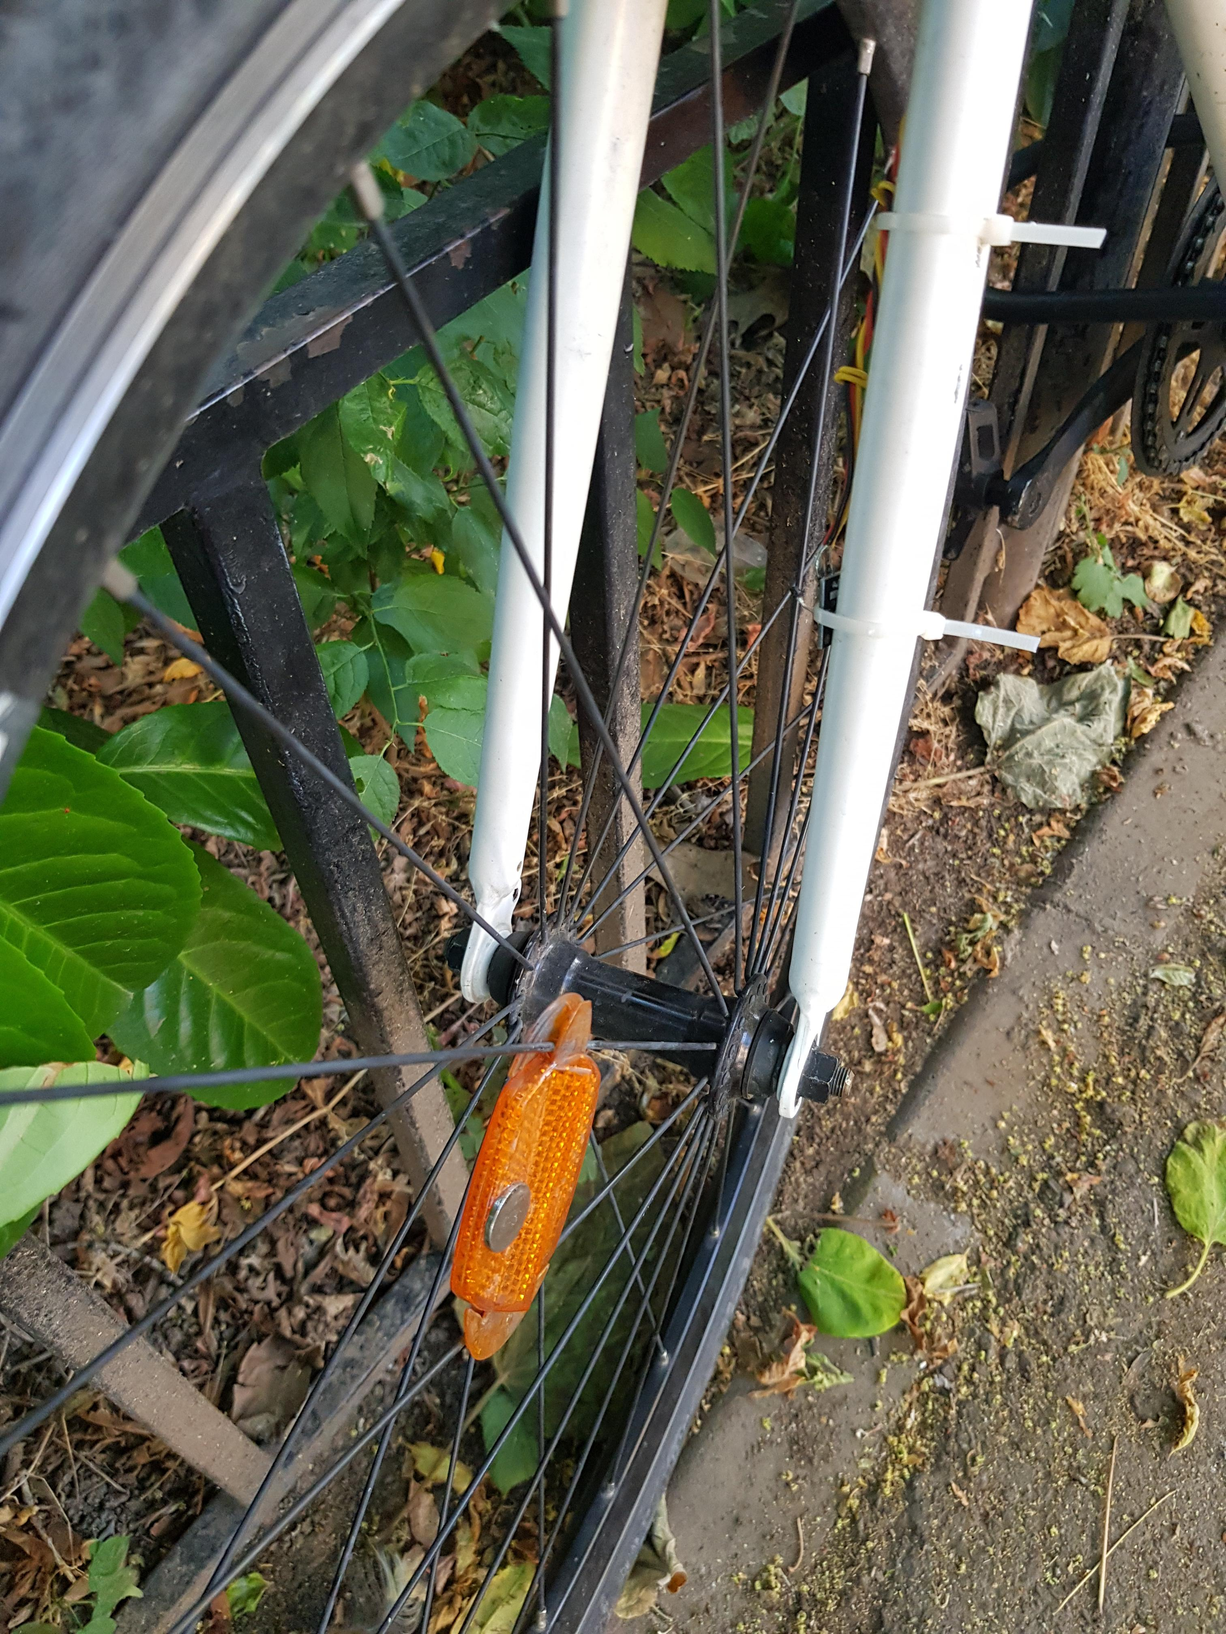
How it works
The battery is held in place with a custom 3D printed holder and a couple of hair ties
The sensor is secured with zip ties

Slide 6
Motivation
I’ve been thinking about getting one for some time
I enjoy seeing stats & finding patterns in my hobbies
I can track anything I’m interested in about my biking
Privacy and security of my data
Custom user interface that can look however I want

Slide 7
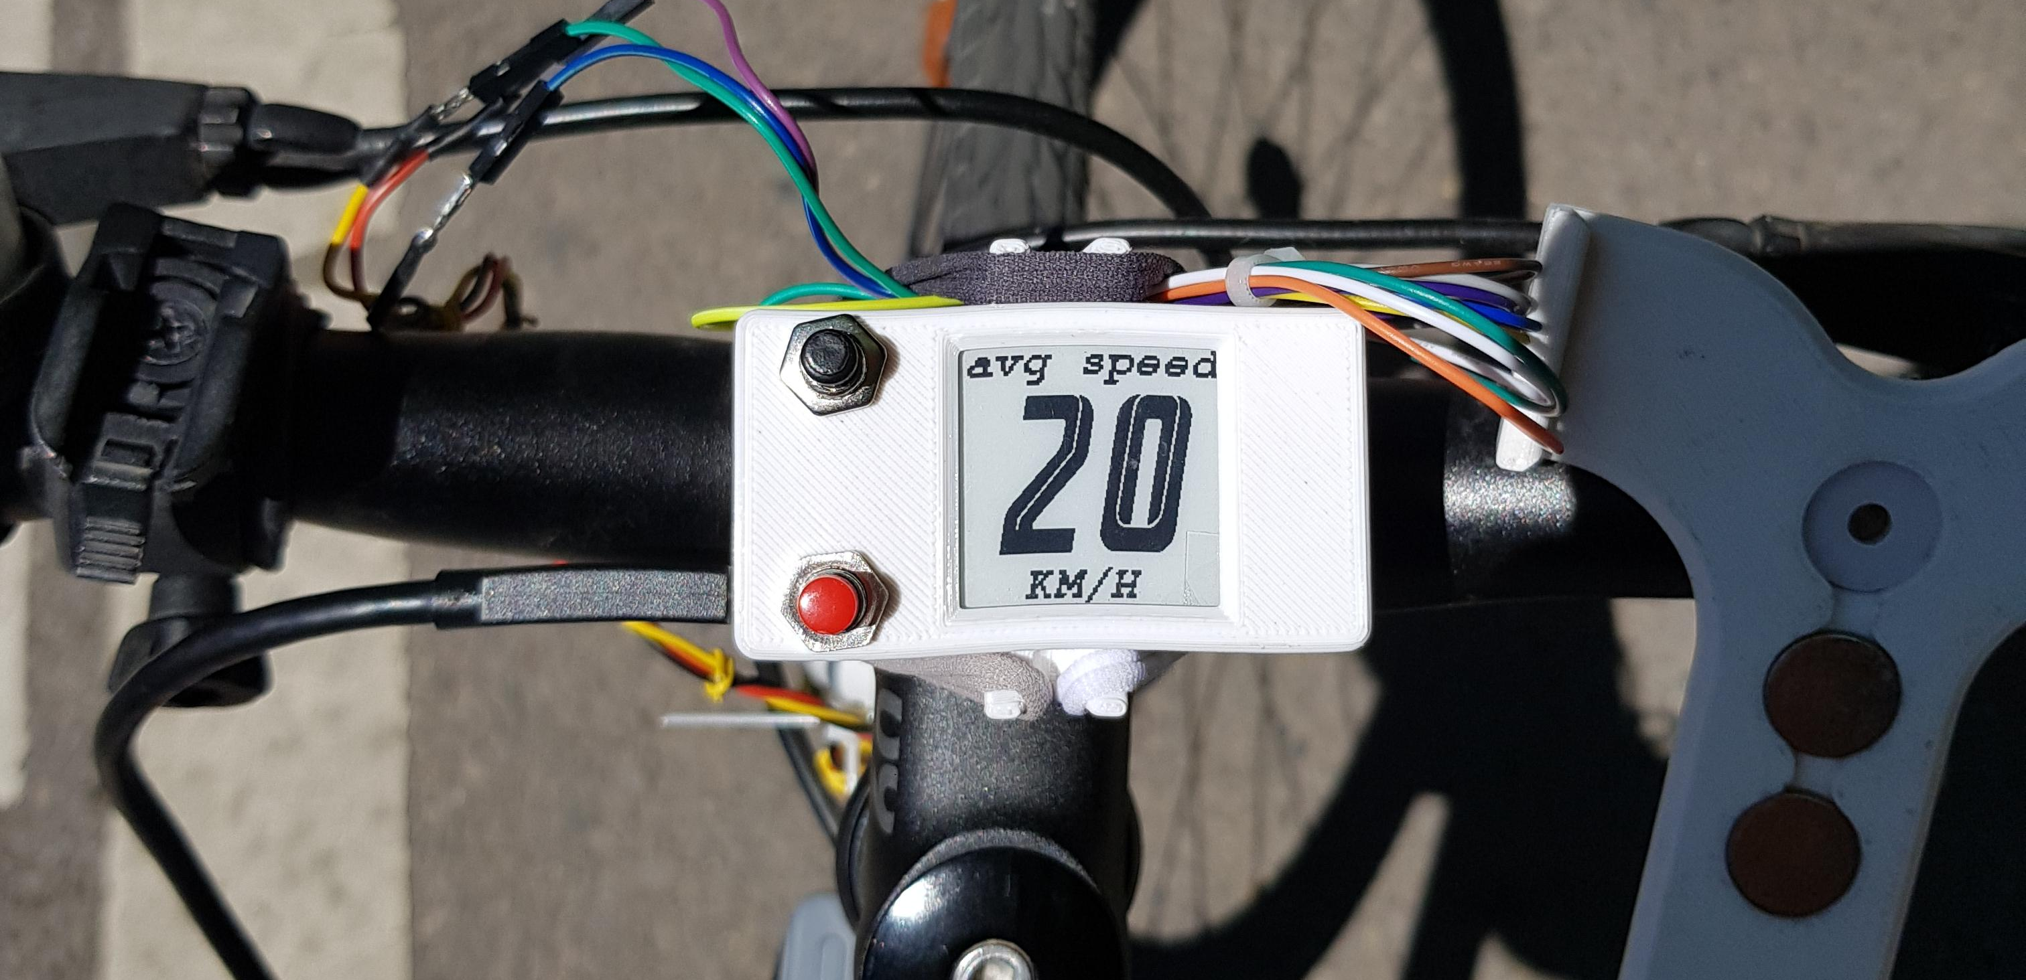
Novelty
Haven’t seen ePaper displays in this field
They are ideal in sunlight (it’s where they shine)
Also work great at night when riding in the city

Slide 8
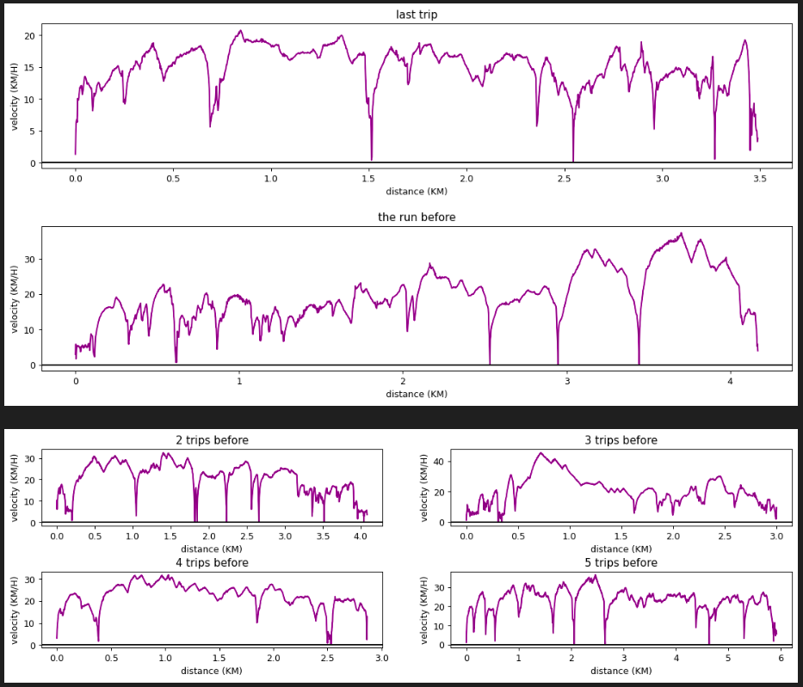
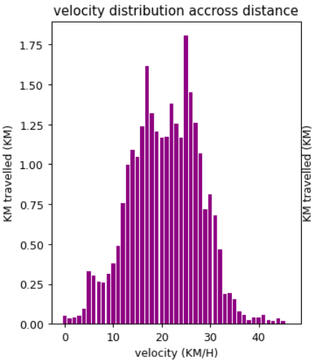
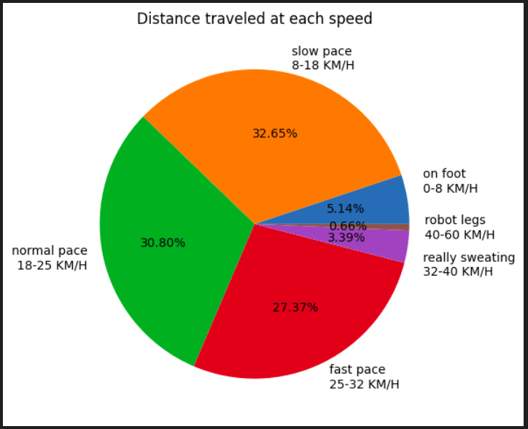
Novelty
There are a lot of interesting things that a self made application can show about a bike trip:

Slide 9
Novelty

Slide 10
Is it useful?
After a week of testing, yes
1 min 10 s to mount on the bike
Light and compact to carry
Never forget the portable phone charger again
Accuracy of around 1 to 1.5 Km/h
Stats are really nice to see

Slide 11
What would I add
Make the red button change main menus
Show force, acceleration, time and distance
Collect more data and try to cluster trips
Learn PCB design and make the project thinner
Incorporate a rechargeable battery
Center the display better

Slide 12
Undergraduate thesis
Do more comprehensive data analysis
Add a camera and detect road signs in real time
Incorporate as many things from the previous slide

Slide 13
Thank you for listening!

